Slide 1
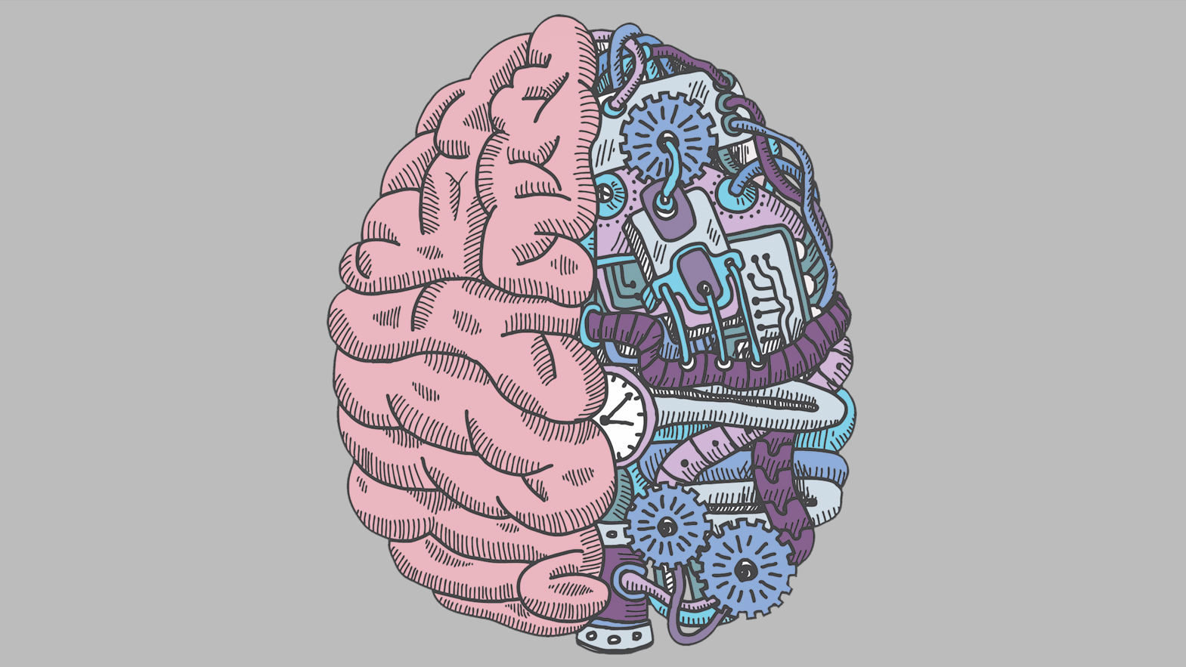
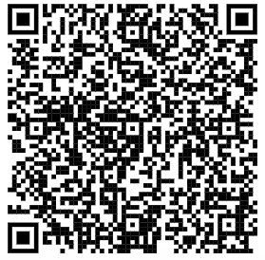
Course Registration
Course
Registration
Workshop
Scan to view slideshow on phone
Presented by Neuro Club

Slide 2
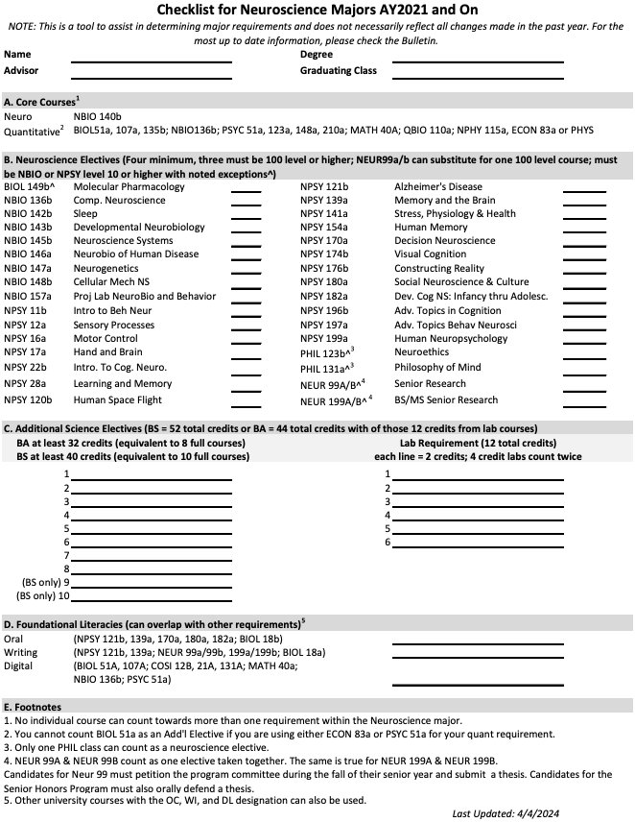
Updated Checklist
New changes include updating which courses can fulfill the oral (OC), writing (WI), and digital (DL) requirements.
Footnote 5: “Other university courses with the OC, WI, and DL designation can also be used.”
BIOL 12B/A do not fulfill these requirements, but they can be used towards Section C lab requirement.

Slide 3
Fall 2024 Electives
NPSY 12A: Perception: Human, Animal and Machine
NPSY 121B: Alzheimer’s Disease Resilience and Risk Factors
NPSY 199A: Human Neuropsychology
NBIO 140B: Principles of Neuroscience * (CORE)
NBIO 142B: Circadian Rhythms and Sleep
NBIO 143B: Developmental Neurobiology
NBIO 148B: Cellular Mechanisms of Neuronal Excitability and Plasticity

Slide 4
NPSY 12A — Perception: Human, Animal, and Machine
Fulfills: Section B neuro elective, section C science elective if section B is already complete
Prerequisite: PSYC 10a or MATH 10a or equivalent AP exam score, or permission of the instructor
Examines the human senses, emphasizing sight and hearing, studied from standpoints of anatomy, physiology, and psychophysics. Insights from the study of special observers, including developmentally immature humans, members of nonhuman species, and people with abnormal sensory systems.
Robert Sekular
Is he retiring?
Capacity: 40
T/R | 3:55pm - 5:15pm
Usually offered every year
Fall 2023 format: lecture style w/ required readings and 3 exams

Slide 5
NPSY 121B — Alzheimer's Disease Resilience and Risk Factors
Fulfills: Section B neuro elective, section C science elective if section B is complete, section D oral or writing requirement
Prerequisites: Junior or Senior standing (at least 56 credits), majoring in psychology, neuroscience, or HSSP. Also open to graduate students in psychology and neuroscience
Provides an overview of Alzheimer’s disease, and the factors that may accelerate disease progression and those factors that may be protective. We will cover a broad array of topics including: neuroimaging and blood biomarkers for Alzheimer’s disease in humans; aging versus preclinical Alzheimer’s disease; modern definitions of Alzheimer’s resilience, reserve and brain maintenance; role of stress and psychopathology as risk factors for Alzheimer’s disease; relationships between Alzheimer’s pathology and cognitive function.
Anne Berry
Capacity: 50
T/R | 3:55pm - 5:15pm
Usually offered every year
Past syllabus not available on Latte

Slide 6
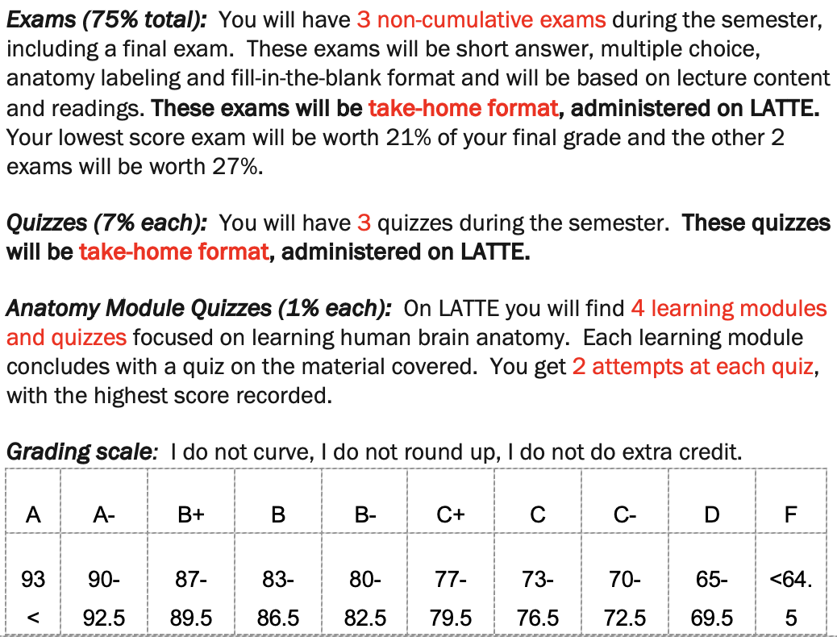
NPSY 199A — Human Neuropsychology
Fulfills: Section B neuro elective, section C science elective if section B is complete
Prerequisites: Psych 10a or Math 10a or equivalent AP exam score, and at least sophomore standing (at least 24 credits) Designed as an introduction to human neuropsychology. Topics include cerebral dominance, neuroanatomical mapping, and localization of function, with special reference to language, memory, and related cognitive function.
Teresa Mitchell
Capacity: 75
M/W/R | 11:15am - 12:05pm
Usually offered every year
Fall 2023 format: lecture style

Slide 7
NBIO 140B — Principles of Neuroscience * (CORE)
Fulfills: Section A neuro core course (cannot be used additionally for section B or C)
Prerequisites: Sophomore standing (at least 24 credits), BIOL 15b, one additional BIOL, BCHM, NBIO or NPSY course and one of the following: One year of college-level chemistry with lab, one year of college-level physics with lab, or any math course above 10a,b. AP scores are not accepted to meet the prerequisite. Junior standing recommended. Examines the fundamental principles of neuroscience. Topics include resting potentials, action potentials, synaptic transmission, sensory systems, motor systems, learning, neural circuits underlying behavior, neurological diseases, and mental illness.
Sonia Kedia (new professor at Brandeis)
Course was previously taught by Professor Vladis, who is no longer here
Capacity: currently unknown
M/W | 4:05pm - 5:25pm
Usually offered every FALL
Lecture style

Slide 8
NBIO 142B — Circadian Rhythms and Sleep
Fulfills: Section B neuro elective, section C science elective if section B is already complete
Prerequisite: NBIO 140b or BIOL 105b Explores via some lecturing, but predominantly discussion of papers from the primary literature, what we know about circadian rhythms and sleep in different organisms. We will discuss the molecular, cellular and circuitry control of rhythms and sleep as well as their behavioral and physiological consequences.
Michael Rosbash and Leslie Griffith
Capacity: 25
T/F | 11:10am - 12:30pm
Usually offered every second year (wasn’t offered Fall 2022)
Lecture + seminar style

Slide 9
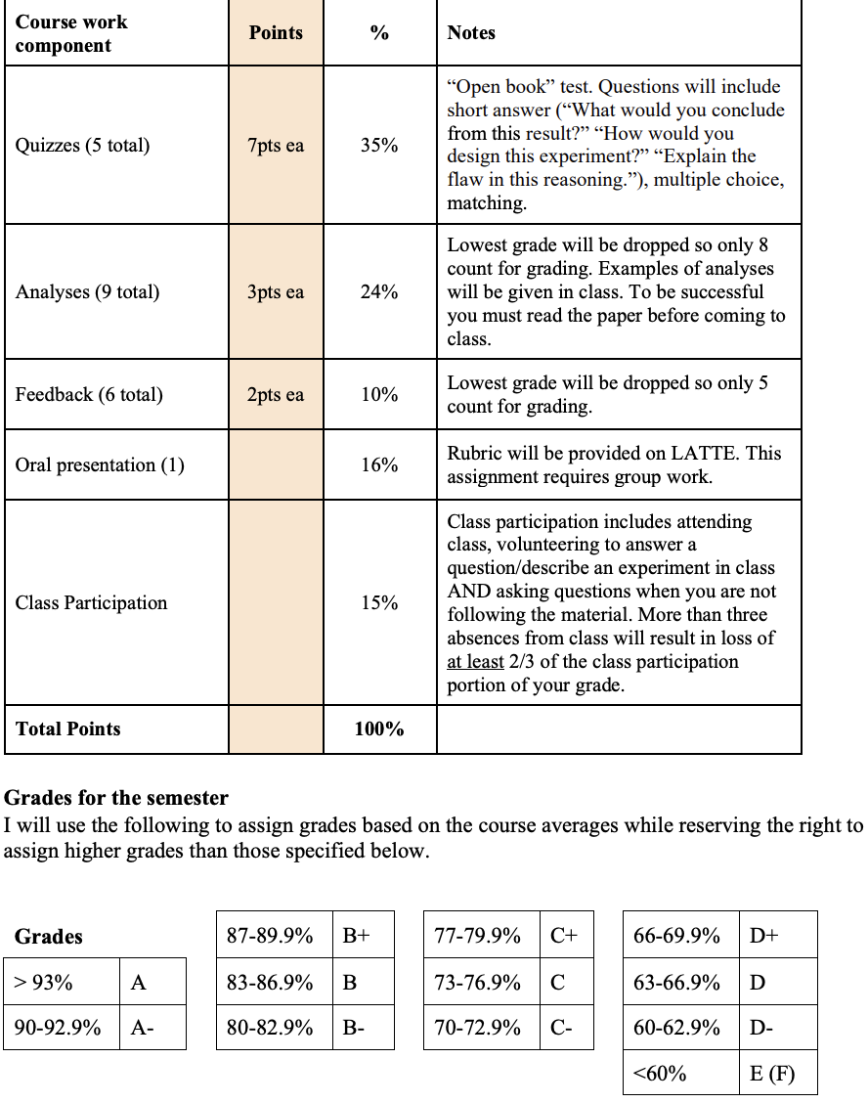
NBIO 143B — Developmental Neurobiology
Fulfills: Section B neuro elective, section C science elective if section B is already complete
Prerequisites: BIOL 14a, BIOL 15b (AP exam score can substitute), and either BIOL 12a or BIOL 18b, or permission of the instructor Discusses the molecular mechanisms used in the development of the nervous system in both invertebrate and vertebrate experimental systems. Topics include determination of neuronal cell fates, axon growth and guidance, plasticity during development, and mechanisms responsible for generation of connectivity in the nervous system. This course emphasizes reading of original scientific research papers and class discussion and oral presentations. If oversubscribed, preference from the waitlist will be given based on seniority.
Suzanne Paradis
Capacity: 30
M/W | 8:30am - 9:50am
Usually offered every second year (was offered Fall 2023)
Fall 2023: lecture + seminar style

Slide 10
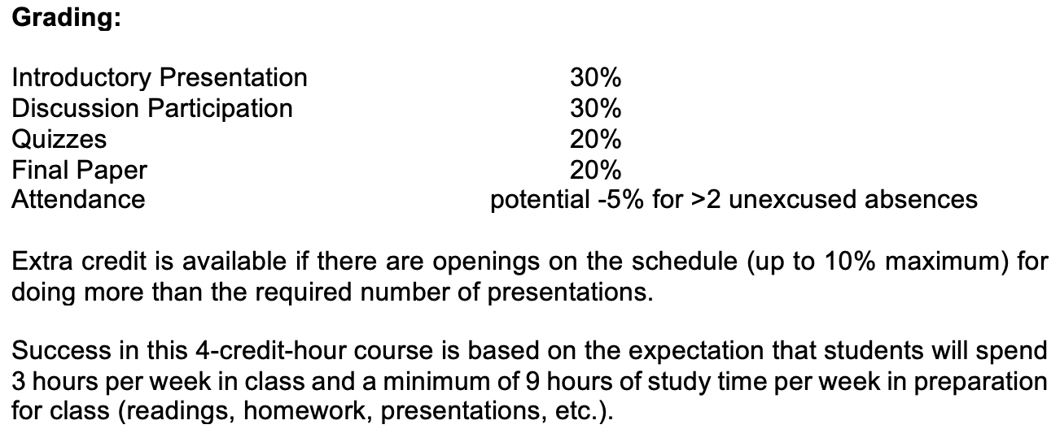
NBIO 148B — Cellular Mechanisms of Neuronal Excitability and Plasticity
Fulfills: Section B neuro elective, section C science elective if section B is already complete
Prerequisite: NBIO 140b or permission of the instructor. Graduate students may take this course concurrently with either NBIO 140b or NBIO 240a Neurons are complex computing devices that transmit and store information. This course will explore the cellular and molecular mechanisms of excitability, as well as the plasticity mechanisms that allow neurons and synapses to store information. Students will examine classic experiments on action potentials and synaptic transmission, as well as the contemporary literature on our evolving understanding of the cellular mechanisms of regulation of excitability and learning-related plasticity. The course emphasizes reading from original papers and extensive class discussion.
Sacha Nelson
Capacity: 25
M/W | 2:30pm - 3:50pm
Usually offered every year (was offered Fall 2023)
Fall 2023: seminar style

